Slide 1
Floyd-Warshall algorithm

Slide 2
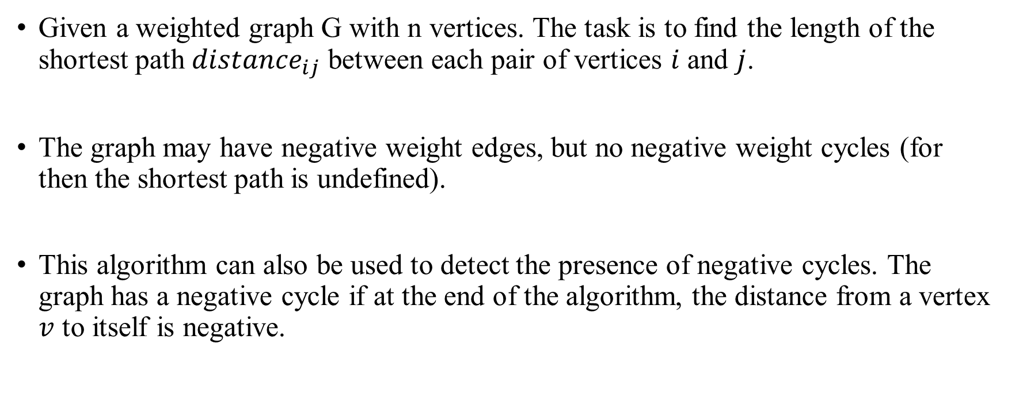
Floyd-Warshall algorithm
Given a weighted graph G with n vertices. The task is to find the length of the shortest path ${distance}_{ij}$ between each pair of vertices $i$ and $j$.
The graph may have negative weight edges, but no negative weight cycles (for then the shortest path is undefined).
This algorithm can also be used to detect the presence of negative cycles. The graph has a negative cycle if at the end of the algorithm, the distance from a vertex $v$ to itself is negative.

Slide 3
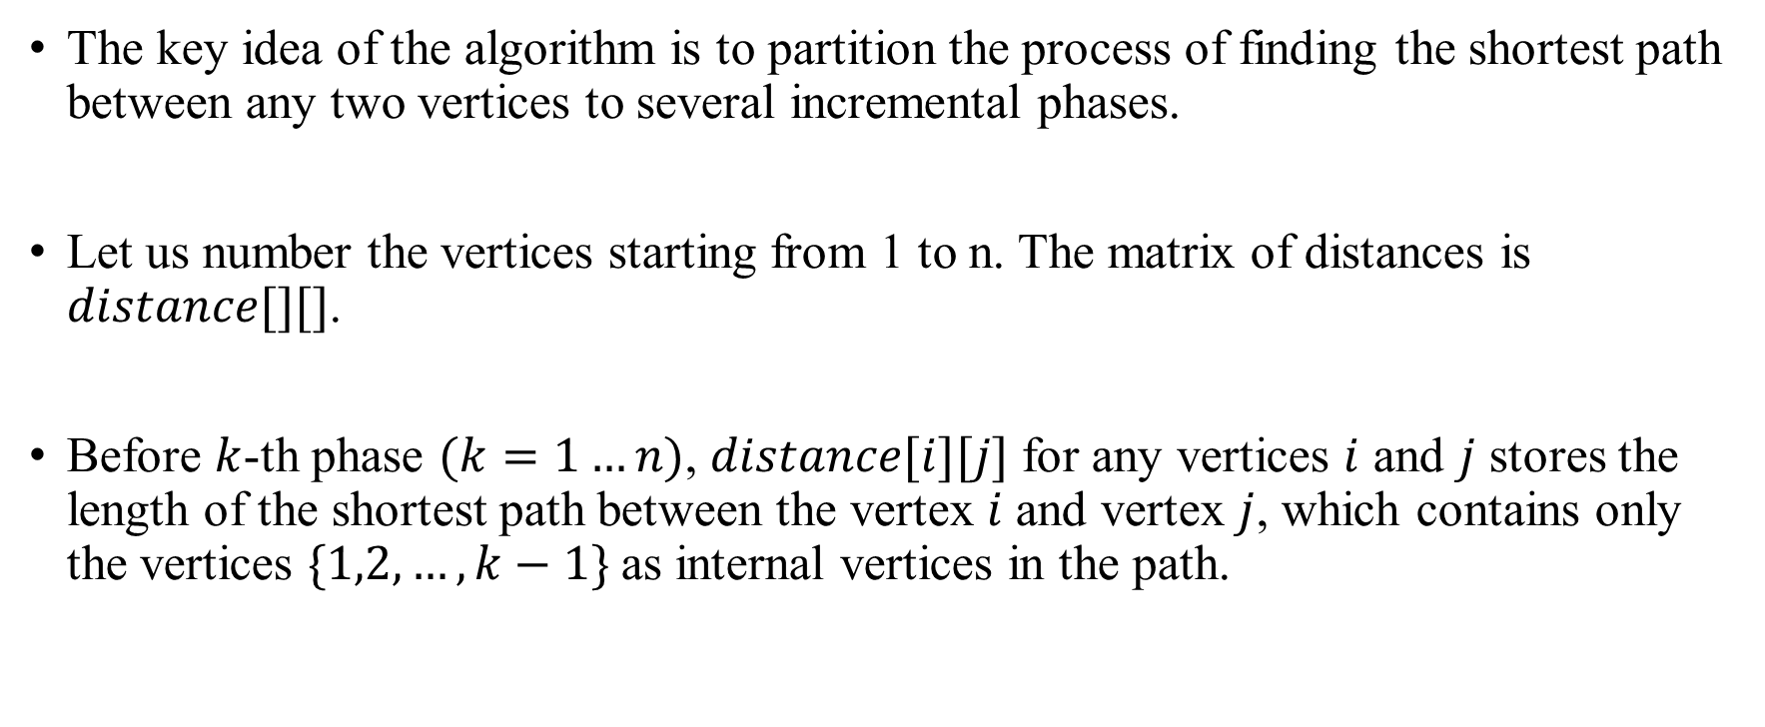
Floyd-Warshall algorithm Algorithm
The key idea of the algorithm is to partition the process of finding the shortest path between any two vertices to several incremental phases.
Let us number the vertices starting from 1 to n. The matrix of distances is $distance[][]$.
Before $k$-th phase $(k=1…n)$, $distance[i][j]$ for any vertices $i$ and $j$ stores the length of the shortest path between the vertex $i$ and vertex $j$, which contains only the vertices $\{1,2,…,k−1\}$as internal vertices in the path.

Slide 4
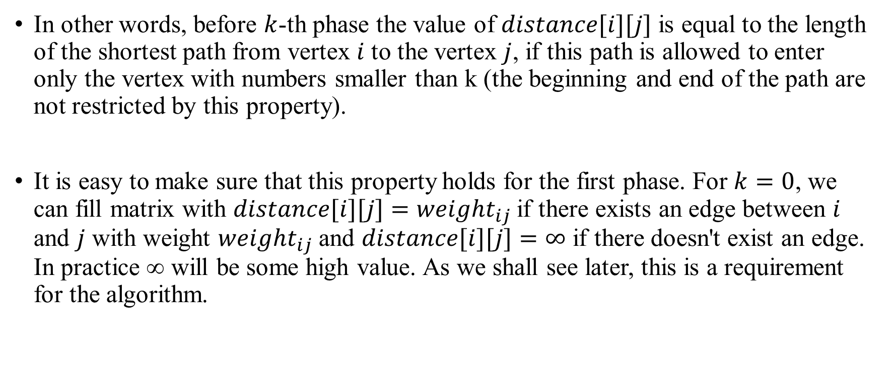
Floyd-Warshall algorithm Algorithm
In other words, before $k$-th phase the value of $distance[i][j]$ is equal to the length of the shortest path from vertex $i$ to the vertex $j$, if this path is allowed to enter only the vertex with numbers smaller than k (the beginning and end of the path are not restricted by this property).
It is easy to make sure that this property holds for the first phase. For $k=0$, we can fill matrix with $distance[i][j]={weight}_{ij}$if there exists an edge between $i$ and $j$ with weight $weight_{ij}$and $distance[i][j]=∞$ if there doesn't exist an edge. In practice ∞ will be some high value. As we shall see later, this is a requirement for the algorithm.

Slide 5
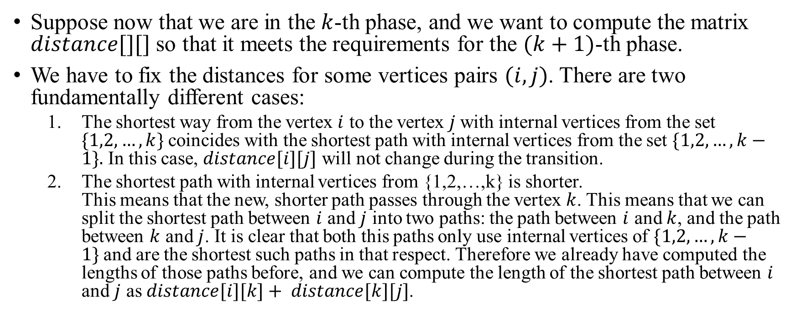
Floyd-Warshall algorithm Algorithm
Suppose now that we are in the $k$-th phase, and we want to compute the matrix $distance[][]$ so that it meets the requirements for the $(k+1)$-th phase.
We have to fix the distances for some vertices pairs $(i,j)$. There are two fundamentally different cases:
The shortest way from the vertex $i$ to the vertex $j$with internal vertices from the set $\{1,2,…,k\}$coincides with the shortest path with internal vertices from the set $\{1,2,…,k−1\}.$ In this case, $distance[i][j]$ will not change during the transition.
The shortest path with internal vertices from {1,2,…,k} is shorter. This means that the new, shorter path passes through the vertex $k$. This means that we can split the shortest path between $i$ and $j$ into two paths: the path between $i$ and $k$, and the path between $k$ and $j$. It is clear that both this paths only use internal vertices of $\{1,2,…,k−1\}$and are the shortest such paths in that respect. Therefore we already have computed the lengths of those paths before, and we can compute the length of the shortest path between $i$ and $j$ as $distance[i][k]+ distance[k][j]$.

Slide 6
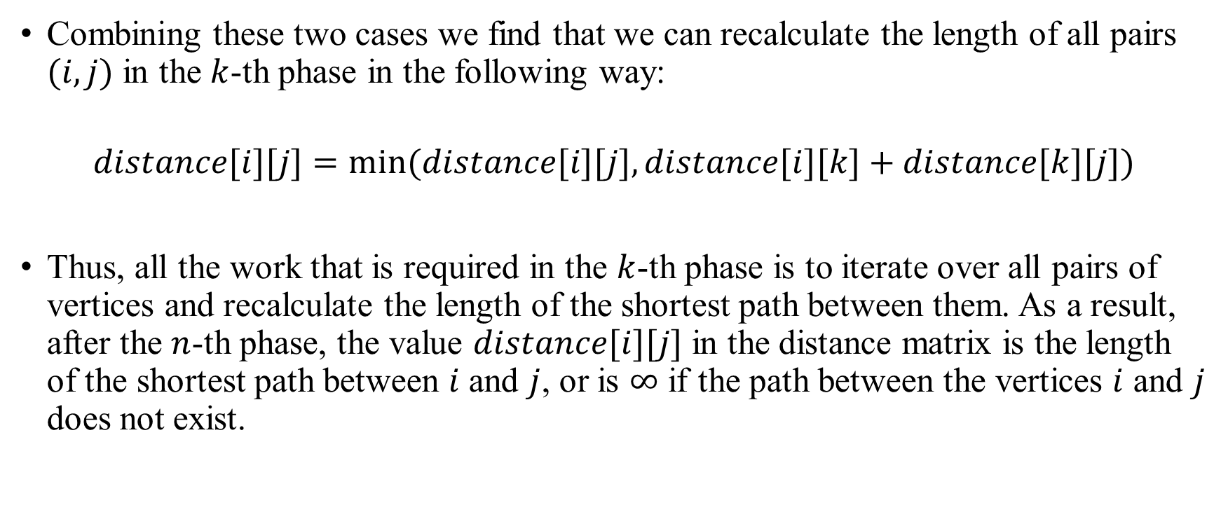
Floyd-Warshall algorithm Algorithm
Combining these two cases we find that we can recalculate the length of all pairs $(i,j)$ in the $k$-th phase in the following way:
$$distance[i][j]=min⁡(distance[i][j],distance[i][k]+distance[k][j])$$
Thus, all the work that is required in the $k$-th phase is to iterate over all pairs of vertices and recalculate the length of the shortest path between them. As a result, after the $n$-th phase, the value $distance[i][j]$ in the distance matrix is the length of the shortest path between $i$ and $j$, or is $∞$ if the path between the vertices $i$ and $j$ does not exist.

Slide 7
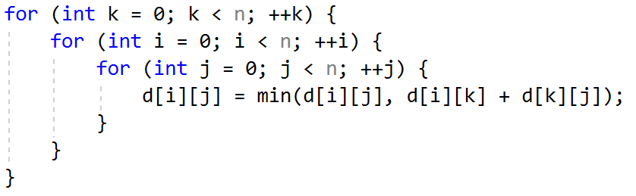

Floyd-Warshall algorithm Implementation
The time complexity of this algorithm is obviously $O(n^{3}).$

